Slide 1

Session3 Group 3
Notes:
Good morning everyone. Today, our group is presenting VIT SMART, a smart training feedback system for muscle fatigue.

Slide 2
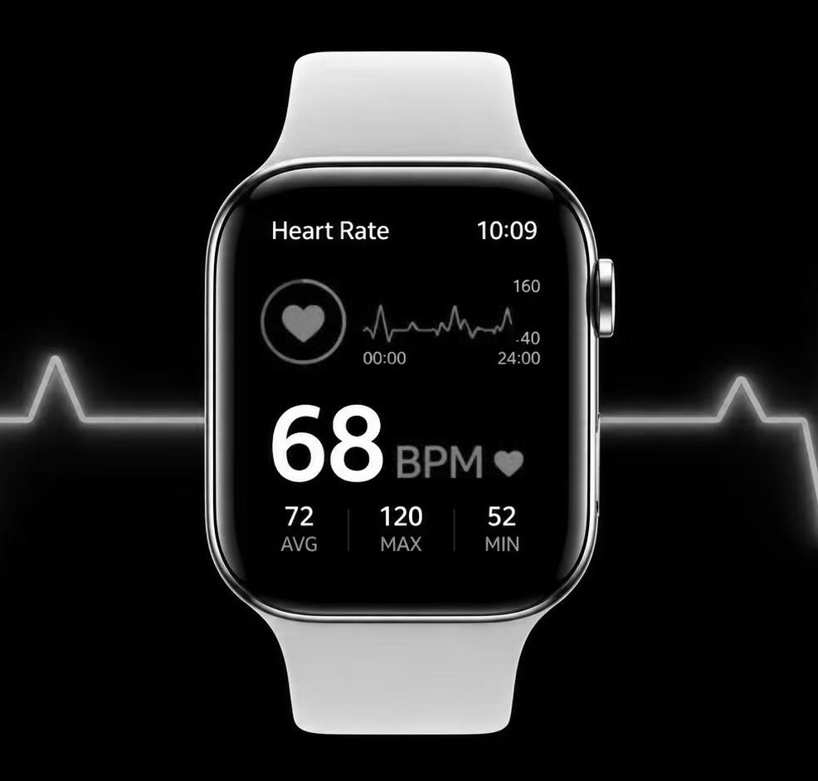
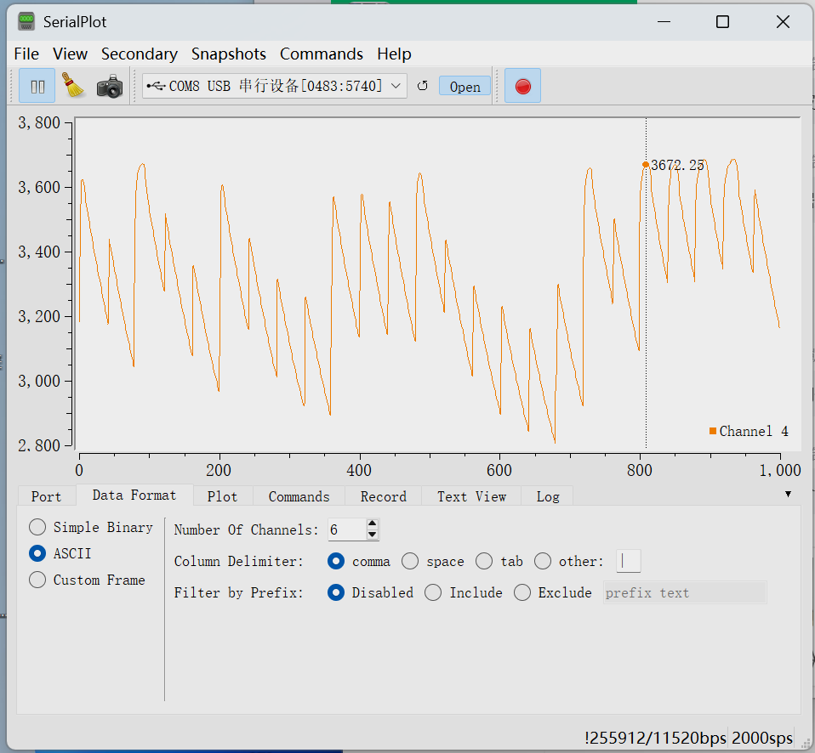
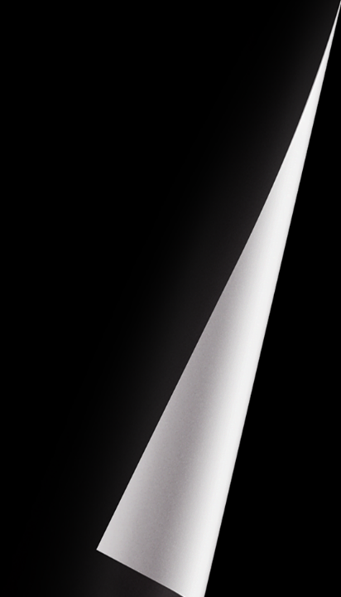
The Problem
“I don’t know when my muscle is actually fatigued — I just guess.”
No muscle-level feedback during exercise
What users see now
What they actually need
Heart rate
Steps
time
Muscle fatigue level
actionable alerts
Real-time AI analysis
Notes:
Stop/continue exercise，base on feeling，would lead to overtraining, injury risk, or ineffective training.
点击ppt
Not lack of data，The users need clearly feedback that helps them make decisions during exercise.

Slide 3
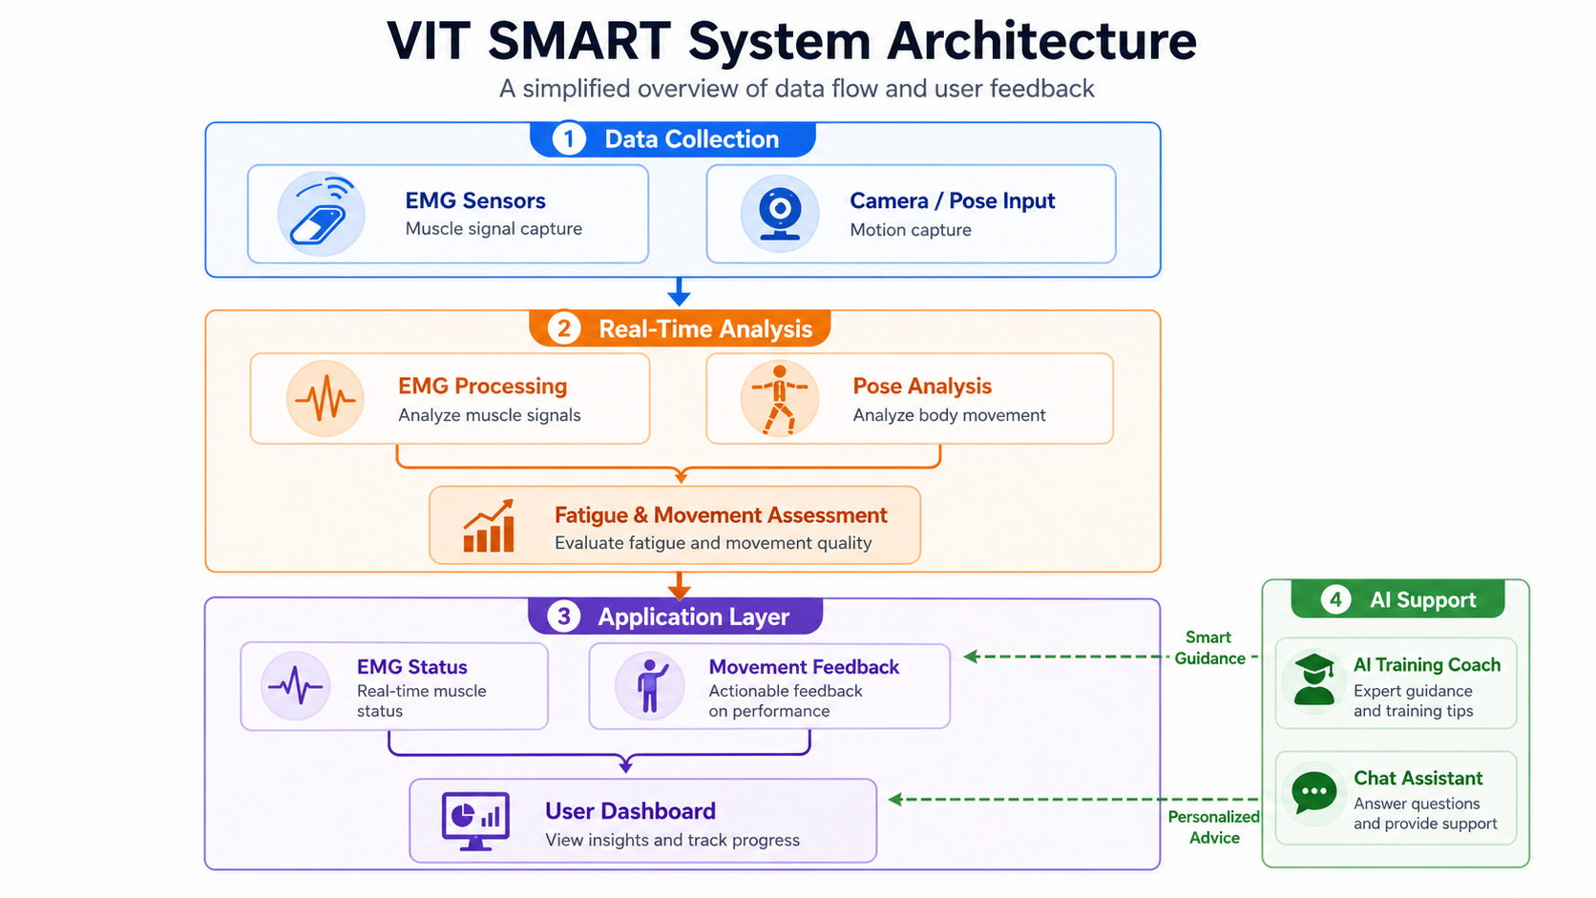

Our Solution
VIT SMART turns complex body signals into clear training decisions.
EMG signal
Pose context
Fatigue
AI guidance

Slide 4

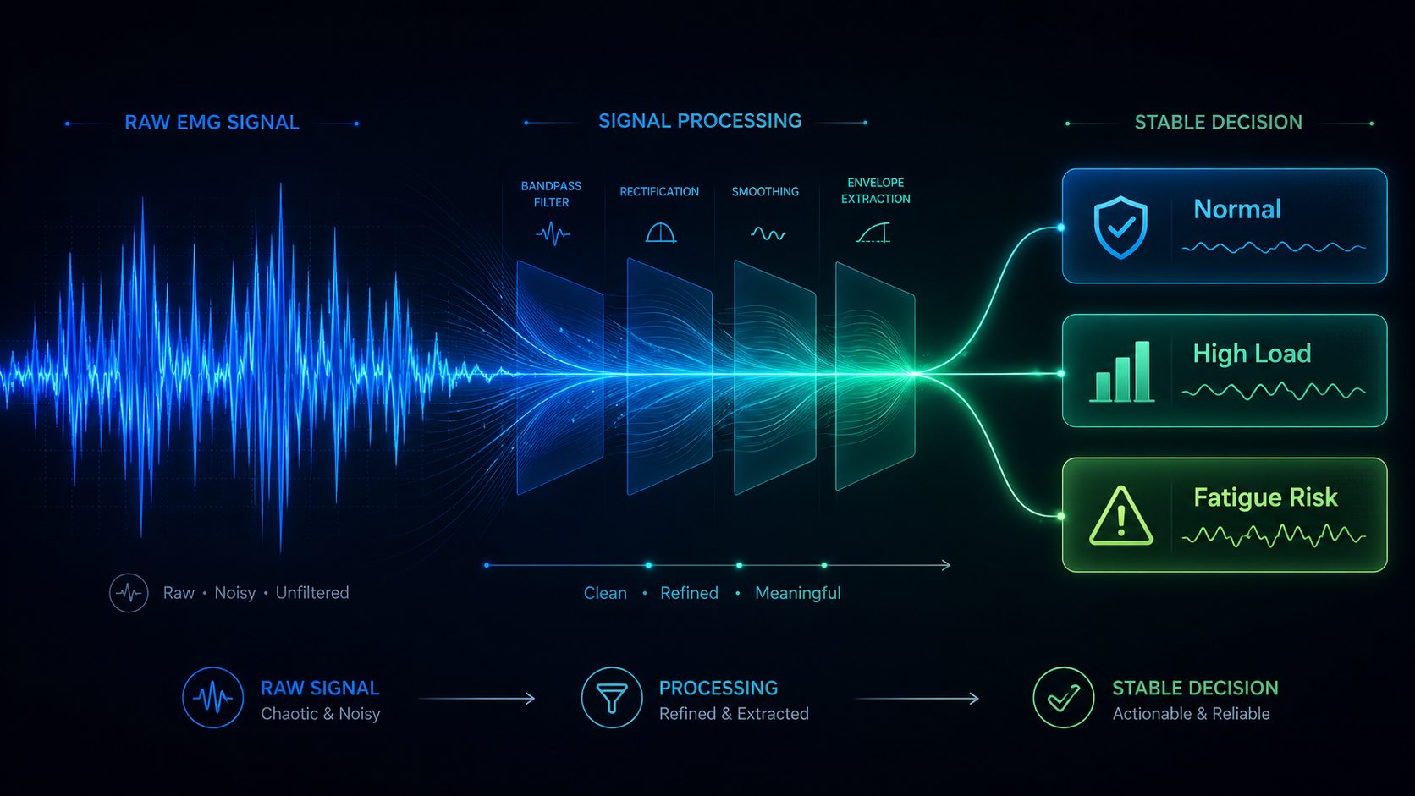
Key Design Decision
System Design
Real-time EMG waveform for continuous signal monitoring
Short sliding window for fatigue classification
Stable and interpretable 3-state output
Separation of visualisation and decision-making
Notes:
Our key design decision is to turn raw EMG signals into a stable three-state output, so users do not need to understand complex waveforms and can quickly get suggestion

Slide 5
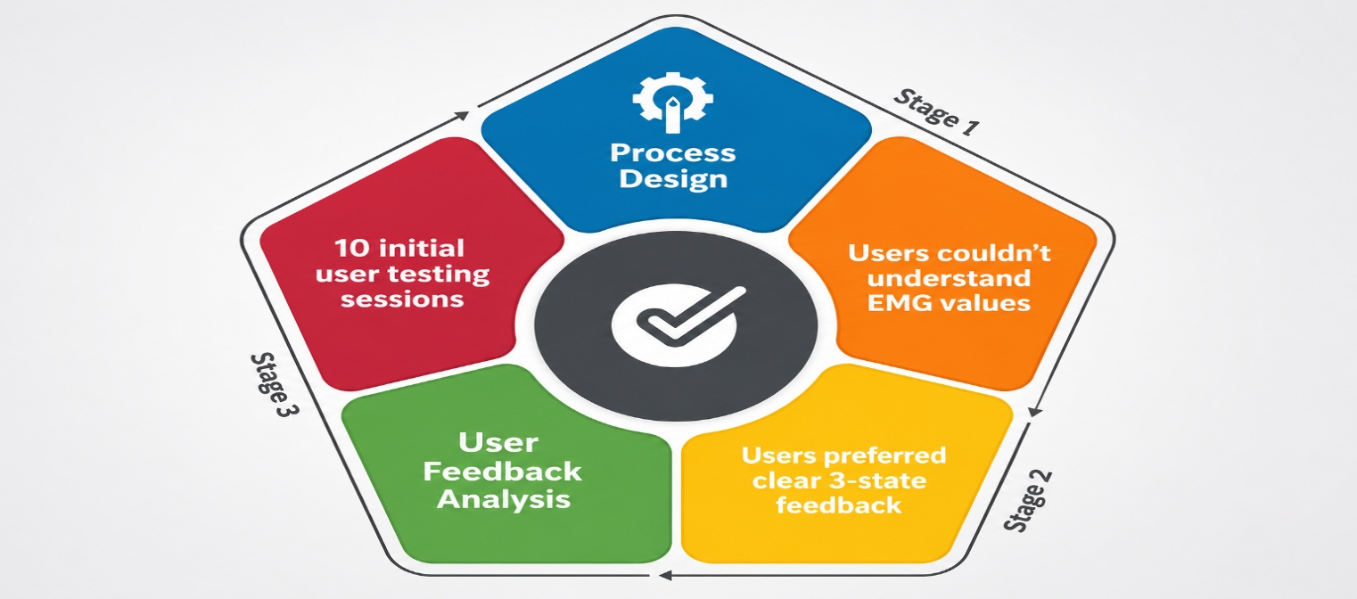

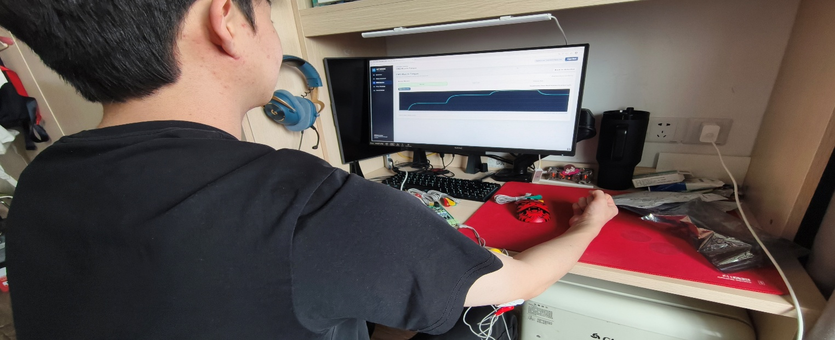
Validation
Before
Raw EMG values
350 / 420 / 510
Confusing & No clear action
After
3-State Feedback
Normal/High Load/Fatigue Risk
Clear decisions & Faster response
Notes:
1，First, users did not understand raw EMG values. They saw the data but do not know what to do with them.
2，users wanted feedback that was quick to read during exercise.
3，users cared more about “what should I do next?” than Professional analysiswhich are difficult to understand

Slide 6


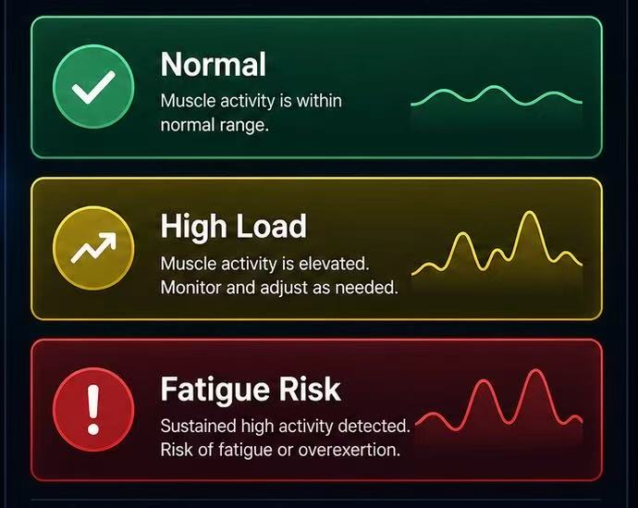
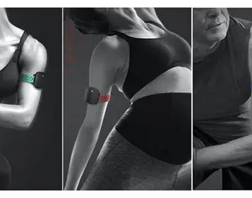
Future Direction
Current Limitation
Signal stability during movement
1
2
3
Next Step 1
Refine fatigue feedback
Next Step 2
Test with more real users
Notes:
EMG signals can be affected by sensor position, body movement, and different exercise types.
1，more personalize 。 Eg，the system could adjust based on the user’s exercise type, training history, and personal fatigue pattern.
2，We would also test with more real users and more workout movements.
What we learn： X fitness data， but more advice or plan hat is easy to understand and useful for action.

Slide 7
Q&A
Notes:
Based on the MOA algorithm, we calculate the average maximum value of the dataset. We set 30% of this value as the boundary between normal and high load, and 90% as the boundary between high load and fatigue risk.

